Slide 1

Contributing to Helm

Slide 2
Before we start off,
Just a few questions

Slide 3
Guess the number of PRs I have raise for helm repository?
My Pull Requests

Slide 4

Totally 17 PRs
9 Merged
8 Closed

Slide 5
Guess the number of issues I have been involved in helm repository?
Issues I got involved in

Slide 6

Totally 91 Issues.
57 Closed. I helped close few of them.
34 Open. I’m trying to help there.

Slide 7
Some of the ways I contributed in...

Slide 8
Reproduce Issues
and Confirm them

Slide 9
Try to find the root cause of the issue - is it an issue with helm?

Slide 10
When helm is the issue - Find code that’s causing the issue. Try to discuss the solutions.

Slide 11
Raise PRs with tests and code. Discuss the code and get it merged

Slide 12
Help someone else to contribute, by analysing issue, reviewing PR code / trying out PR code

Slide 13
Some of my Learnings

Slide 14
No tool is perfect.
Helm has so many bugs.
People create issues / comment on existing ones almost every single day!

Slide 15
Trying to close every other issue is so tough by yourself!
It’s like working on production support and getting tickets every hour!

Slide 16
Doing it all alone might sound cool, but it requires so much time and effort. Get help from community members who are willing to raise PRs!

Slide 17
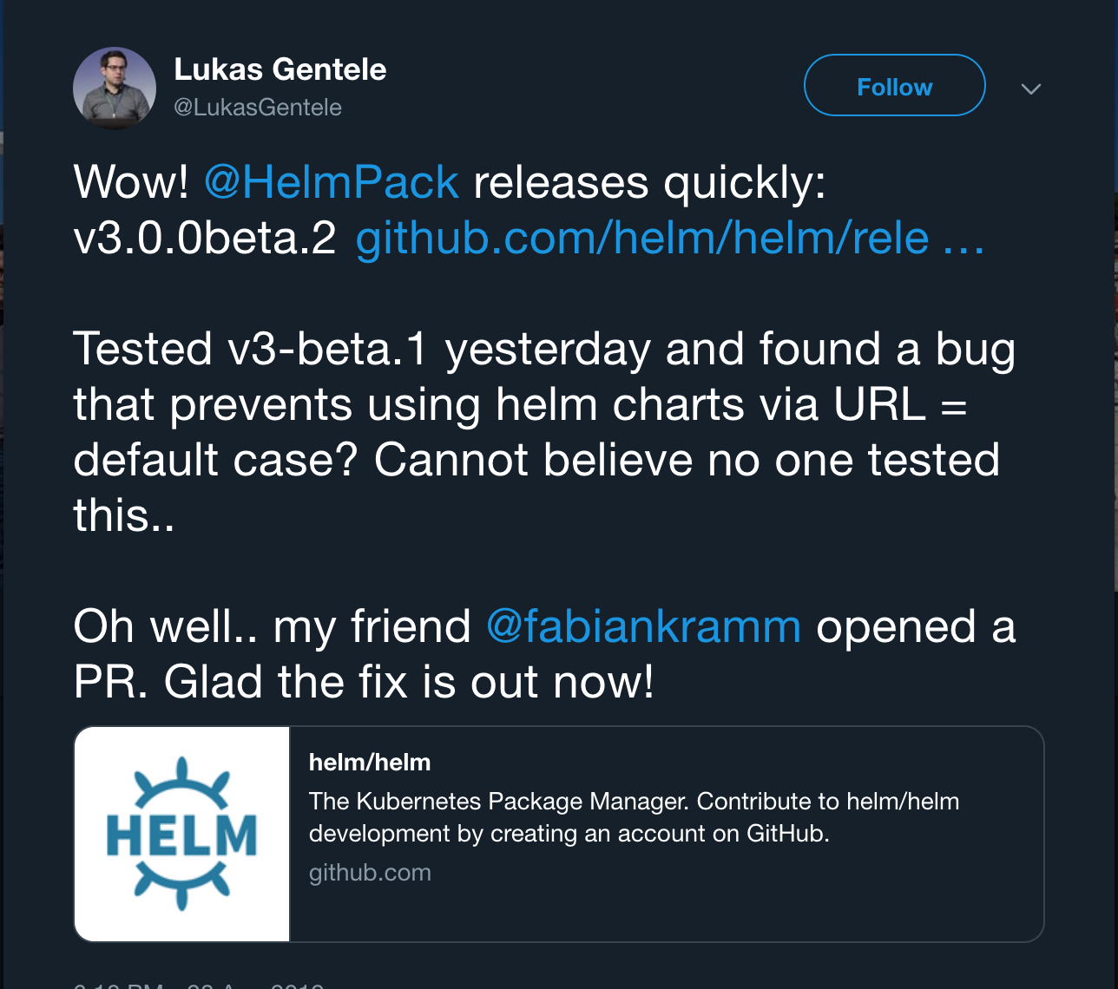

Slide 18
Helm v3 has lots of bugs. Lots of them go unnoticed because of lack of some tests.

Slide 19
Starting from bugs in simplest of features, to crazy issues like helm linting feature working in Linux and MacOS, but not working in Windows. Some back slash issue

Slide 20
Some things that I have tried to do while contributing is - try to comment on PRs if they don’t have failing tests for the issue

Slide 21
Now, some takeaways for you:

Slide 22
You can contribute to Open Source too!
Anyone can!

Slide 23
If you are interested, you can start small and start contributing. Don’t give yourself excuses to not contribute

Slide 24
Choosing projects - you can choose any project you like.
It can be big or small.
Just do it! Don’t think!

Slide 25

Open Source Needs You.

Slide 26
Why contribute in the first place?

Slide 27
Before answering that, let’s take a look at this

Slide 28
How many of these languages do you think are open source?

Slide 29
















Slide 30
What about these softwares ? How many are open source?

Slide 31

























Slide 32
Many Open Source repositories are out there! We use so many of them. For free and with freedom! We can contribute a bit back

Slide 33
Bottom line:
Open Source can survive only if it gets contributions in some way or the other. Or it will not sustain and people will not trust them anymore.

Slide 34
Thank You!

